Slide 1
Stacks And Queues
Module-2

Slide 2
Stack
Ordered collection of items ,where elements are inserted from one end & deleted from same end
Position from where the items are inserted & deleted is called as top of the stack
LIFO/FILO
Operations & array representation of stacks
1. Push : Inserting an element on the top of stack
2. Pop : Deleting an element from the top of the stack
3. Display : Display the contents of the stack

Slide 3
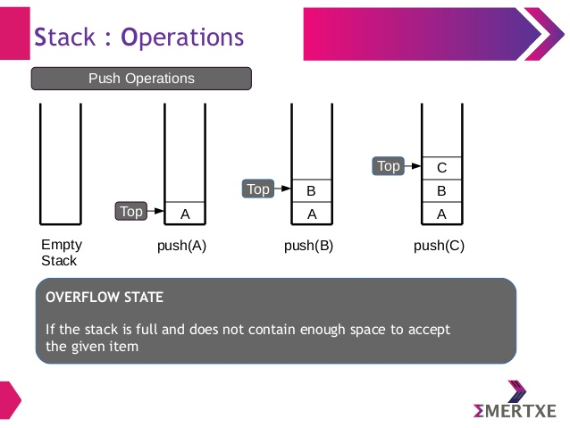
Push operation
Only one item is inserted at a time & that item should be inserted from top of the stack
When stack is full !!
It is not possible to insert any element
Trying to insert an extra element results in overflow of the stack

Slide 4
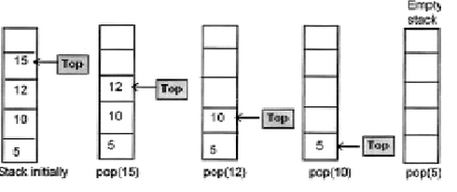
Pop operation
Only one element can be deleted at a time and item that has to be deleted only from top of the stack
When stack is empty !!
Not possible to delete any item
If we try to delete any element from the stack it results in stack underflow

Slide 5
Display operation
If stack has some items , all these items are displayed one after the other
When stack is empty display code should include an error condition for stack empty

Slide 6
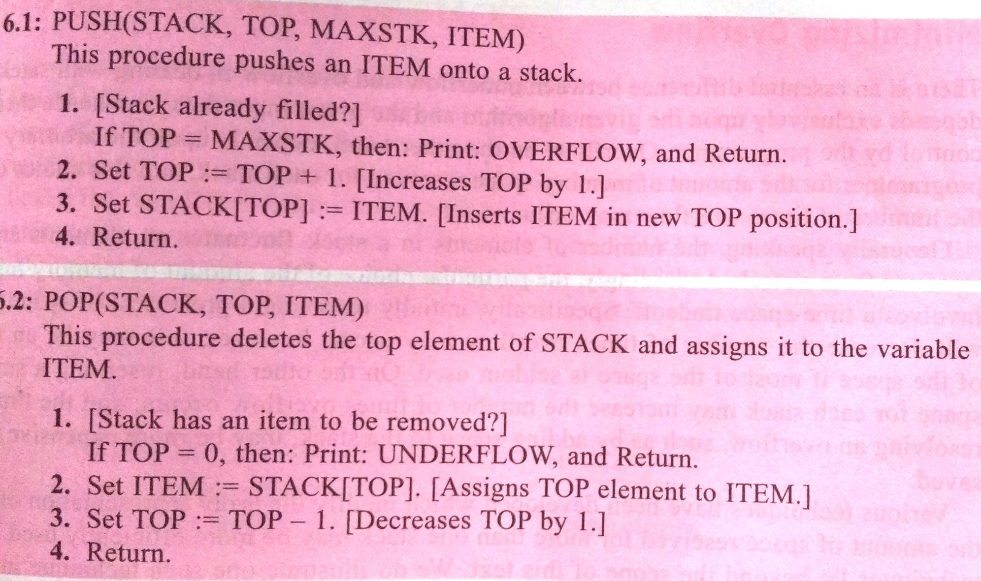
Push & Pop

Slide 7
Stacks using Dynamic Arrays
At compile time, How large the stack will become?
Dynamic allocation ,increase the size of this array as needed
Functions (initial capacity =1)
CreateS ,IsEmpty , IsFull

Slide 8
Stack CreateS( ) :: =typedef struct {
int key;
/* other fields */
} element;
element *stack;
MALLOC(stack,sizeof(*stack));
int capacity=1;
int top=-1;
Boolean IsEmpty(Stack) ::=top<0;
Boolean IsFull(Stack) ::= top>=capacity-1;

Slide 9
In push() ,Replace MAX_SIZE with capacity
Unchange pop()
Stack full with array doubling
void push(element item )
{
if(top==capacity-1)
{
REALLOC(stack,2*capacity*sizeof(stack))
capacity*=2;
}
stack[++top]=item;
}

Slide 10
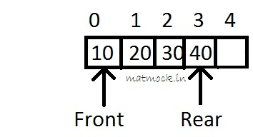
Queues(FIFO)
Is an ordered list in which insertion & deletion takes place at different ends
Rear end : end at which new elements are added
Front end : end from which old elements are deleted
Pictorial Representation

Slide 11
Operation on Queue
#define MAX_SIZE 4
typedef struct
{
int front,rear;
int item[MAX_SIZE];
} queue;
queue q;
q.front=0;
q.rear=-1;

Slide 12
Insert an item from queue
void insert(int n)
{
if(q.rear== MAX_SIZE-1)
printf(“Queue is full”);
else
q.item[++q.rear]=n;
}

Slide 13
Delete from the front end
int delete( )
{
if (rear < front)
printf(“Queue is empty);
else
return q.item[q.front++];
}

Slide 14
Display the contents of queue
void display ( )
{
int i;
if(q.rear < q.front)
printf(“Queue is empty”);
else
{
printf(“Contents of queue are “);
for(i=q.front;i<=q.rear;i++)
printf(“%d”,q.item[i]);
}
}

Slide 15
Circular queue
In ordinary queue ,we reach one stage when we say that queue is full even if some elements are deleted from queue
This problem can be eliminated by using circular queue
Adding an element to a circular queue
Deleting an element from a circular queue
Displaying an element from a circular queue

Slide 16
Circular queue
#define MS 5
typedef struct
{
int front,rear;
int item[MS];
}cqueue;
cqueue cq;
cq.front=MS-1;
cq.rear=MS-1;

Slide 17
Insert
void cqinsert(int val)
{
if(cq.front==(cq.rear+1)%MS)
{
printf("Circular queue is full\n");
}
else
{
cq.rear=(cq.rear+1)%MS;
cq.item[cq.rear]=val;
}
}

Slide 18
Delete
int cqdelete()
{
int value;
if(cq.front==cq.rear)
{
printf("Circular queue is empty\n");
}
else
{
cq.front=(cq.front+1)%MS;
value = cq.item[cq.front];
printf("The deleted element is %d \n",value);
}
}

Slide 19
else
{
if(cq.front!=(MS-1))
for(i=cq.front+1;i<=(MS-1);i++)
{
printf("%d\t",cq.item[i]);
}
for(i=0;i<=cq.rear;i++)
{
printf("%d\t",cq.item[i]);
}
}
}
}
void cqdisplay()
{
int i;
if(cq.front==cq.rear)
{
printf("Circular queue is empty\n");
}
else
{
if(cq.front < cq.rear)
{
for(i=cq.front+1;i<=cq.rear;i++)
{
printf("%d\t",cq.item[i]);
}
}

Slide 20
Circular queue using dynamically allocated arrays
To add an element to a full queue we must first increase the size of the array using a function such as realloc
Configuration may be obtained as follows
1)Create a new array newQueue of twice the capacity
2)Copy the second segment(queue[front+1] through queue[capacity-1])to positions in newQueue beginning at 0
3)Copy the first segment(element queue[0] through queue[rear]) to positions in NewQueue beginning at
capacity –front-1
Note : The function copy(a,b,c) copies element from locations a through b-1 to locations beginning at c

Slide 21
Doubling Queue capacity
void queueFull()
{
element* newQueue;
MALLOC(newQueue,2*capacity*sizeof(*queue));
/*copy from queue to newQueue*/
int start=(front+1)%capacity;
if(start<2)
copy(queue+start,queue+start+capacity-1,newQueue);
else
{/*queue wraps around*/
copy(queue+start,queue+capacity,newQueue);
copy(queue ,queue+rear+1,newQueue+capacity-start);
}
/*switch to new queue*/
front=2*capacity-1
rear=capacity-2;
capacity*=2
free(queue);
queue=newQueue;
Capacity=8
front=5
rear=4
queue=0
newQueue=0

Slide 22
Recursion
Suppose P is a procedure containing either a Call statement to itself or a Call statement to a second procedure that may eventually result in a Call statement back to original procedure P
Then P is called a recursive procedure
Two Properties
Base criteria,for which the procedure does not call itself(base values)
Each time procedure does call itself .it must be closer to the base criteria(base value)

Slide 23
Factorial function
n! = 1.2.3. ……(n-2)(n-1)n
Function
If n==0,then n!=1
If n>0,then n!=n.(n-1)!
PROCEDURE : FACTORIAL(FACT,N)
1)If N=0,then :Set FACT:=1. and Return
2)Call FACTORIAL(FACT,N-1).
3) Set FACT:=N*FACT.
4)Return

Slide 24
Fibonacii Sequence
0,1,1,2,3,5,7,8,13,21,34,55, …..
F₀=0,F₁=1
(Fibonacii Sequence)
a)If n=0 or n=1 then F_{n}=n
b)If n>1,then F_{n=}F_{n-2} + F_{n-1}
FIBONACCI(FIB,N)
1)If N=0 or N=1,then :Set FIB:=N, and Return
2)Call FIBONACCI(FIBA,N-2).
3)Call FIBONACCI(FIBB,N-1).
4)Set FIB:=FIBA+FIBB.
5)Return.

Slide 25
GCD
int gcd(int n1, int n2)
{
if (n2!=0)
return gcd(n2, n1%n2);
else
return n1;
}
Ex : gcd for 81, 153 ?
gcd for 24,18 ?

Slide 26
Ackermann Function
1)If m=0,then A(m,n)=n+1
2)If m≠0 but n=0,then A(m,n)=A(m-1,1)
3)If m≠0 & n≠0 ,then A(m,n)=A(m-1, A(m,n-1))
Base Criteria
(0,0) , (0,1), (0,2),(0,3), …..,(0,n),….
Evaluate A(1,3) ?

Slide 27
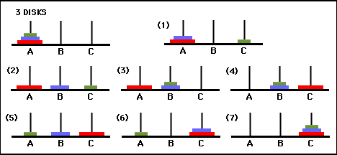
Tower of Hanoi
Consider 3 pegs A , B & C & suppose on peg A there are placed a finite number n of disks with decreasing order
Rules
1)Only one disk may be moved at a time
2)At no time can a larger disk be placed on a smaller disk

Slide 28
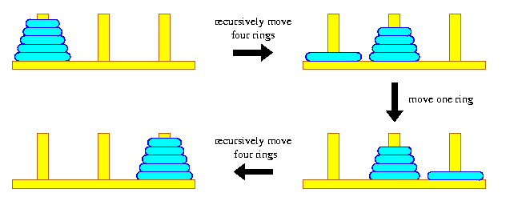
For n=3 : A→C ,A→B ,C→B , A→C, B→A, B→C, A→C
For completeness ,we also give the solution to the Towers of Hanoi problem for n=1 & n=2
n=1 : A→C (one move)
n=2 : A→B , A→C , B→C (3 moves)
Technique of recursion to develop a general solution
Move the top n-1 disks from peg A to peg B
Move the top disk from peg A to peg C
Move the top n-1 disks from peg B to peg C

Slide 29
When n=1,
TOWER(1, BEG,AUX,END) BEG→END
When n>1
1) TOWER(N-1,BEG,END,AUX)
2) TOWER(1, BEG,AUX,END) or BEG→END
3) TOWER(N-1,AUX,BEG,END)

Slide 30
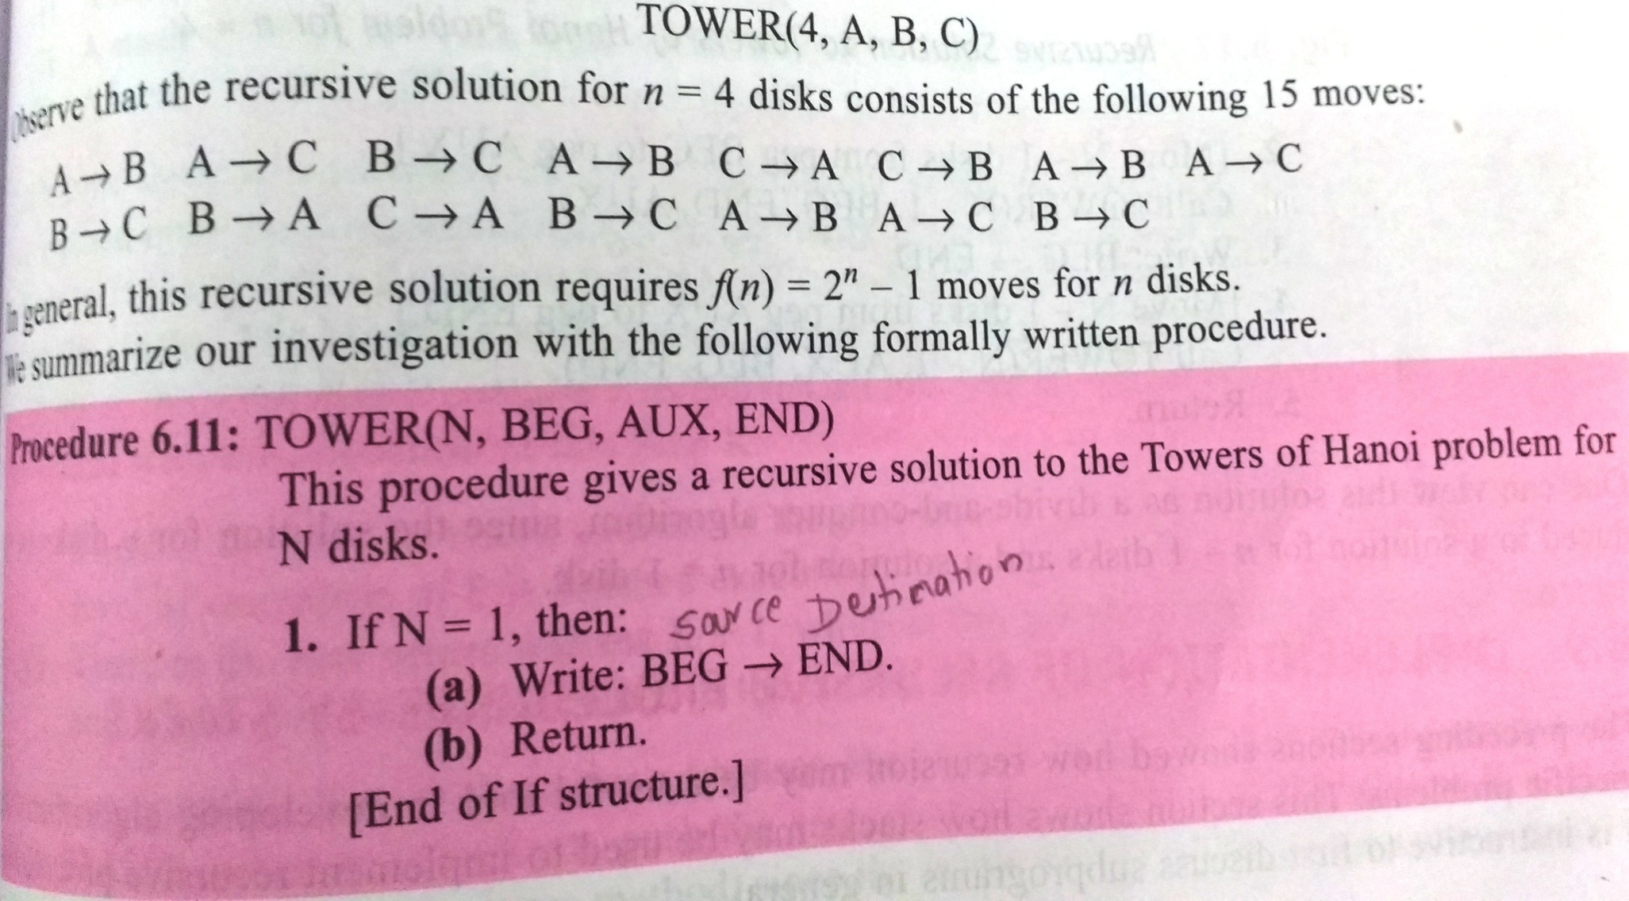

Slide 31
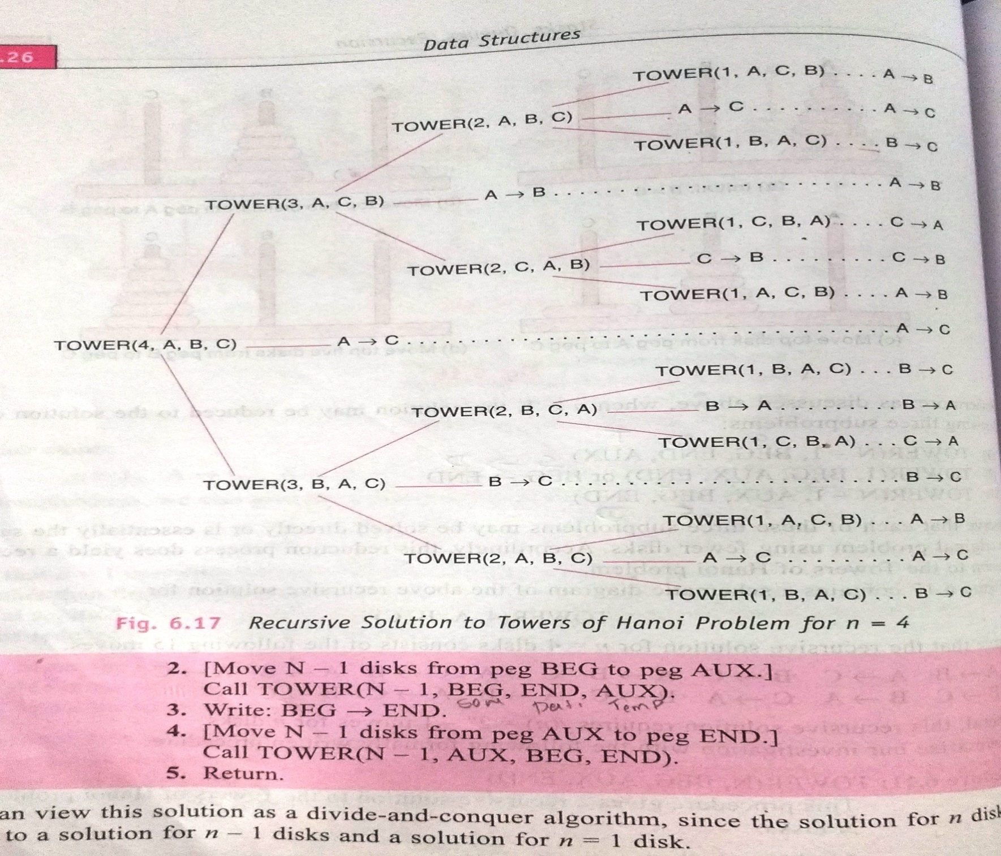

Slide 32
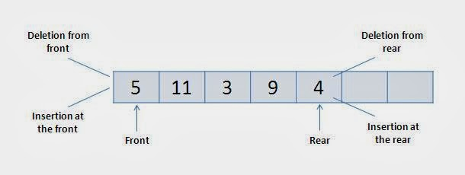
Deques
Double Ended queue.
Insertion as well as deletion can be carried out either at the rear end or the front end.
Input-restricted deque
Output-restricted deque

Slide 33
Priority Queues
Collection of elements such that each element has been assigned a priority & such that order in which elements are deleted & processed comes from the following rules
An element of higher priority is processed before any element of lower priority
Two elements with the same priority are processed according to the order

Slide 34
One-Way List Representation of a Priority Queue
Each node in the list will contain 3 items of info : an info field INFO , a priority number PNR & a link number LINK
A node X precedes a node Y in the list
(1) When X has higher priority than Y
(2) When both have the same priority but X was added to the list before Y

Slide 35
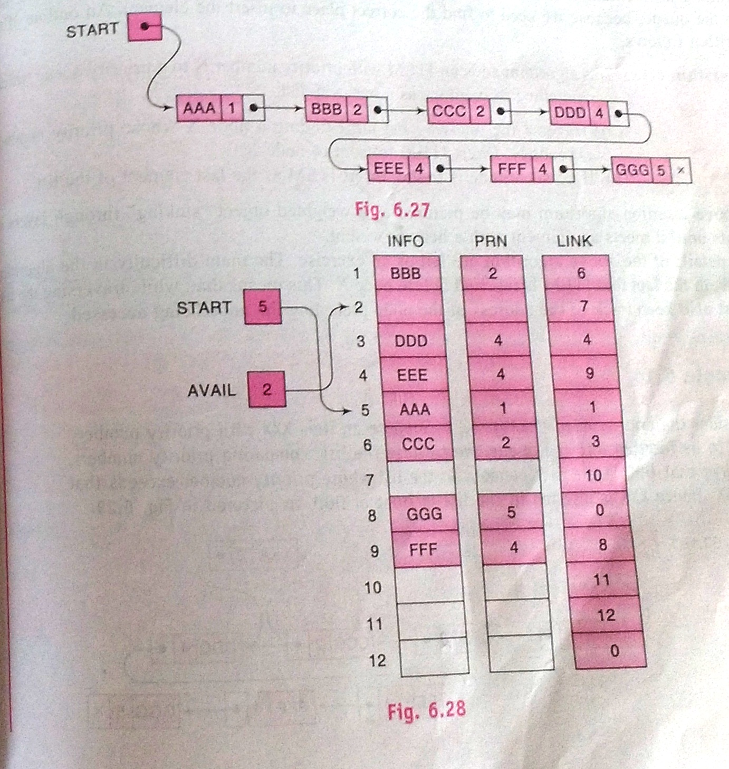

Slide 36
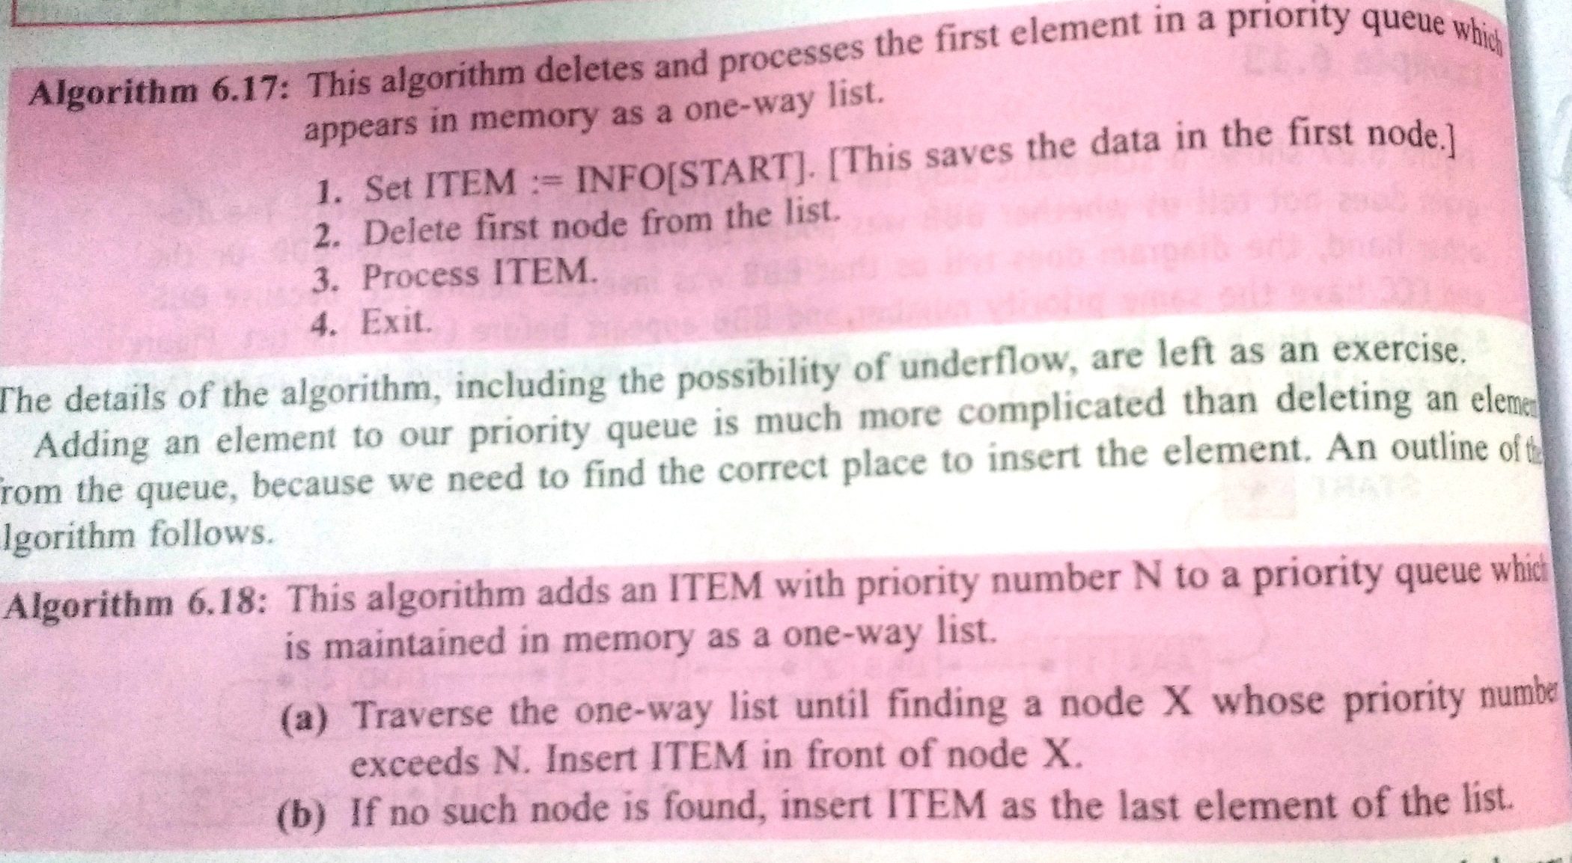
Process & Insertion

Slide 37
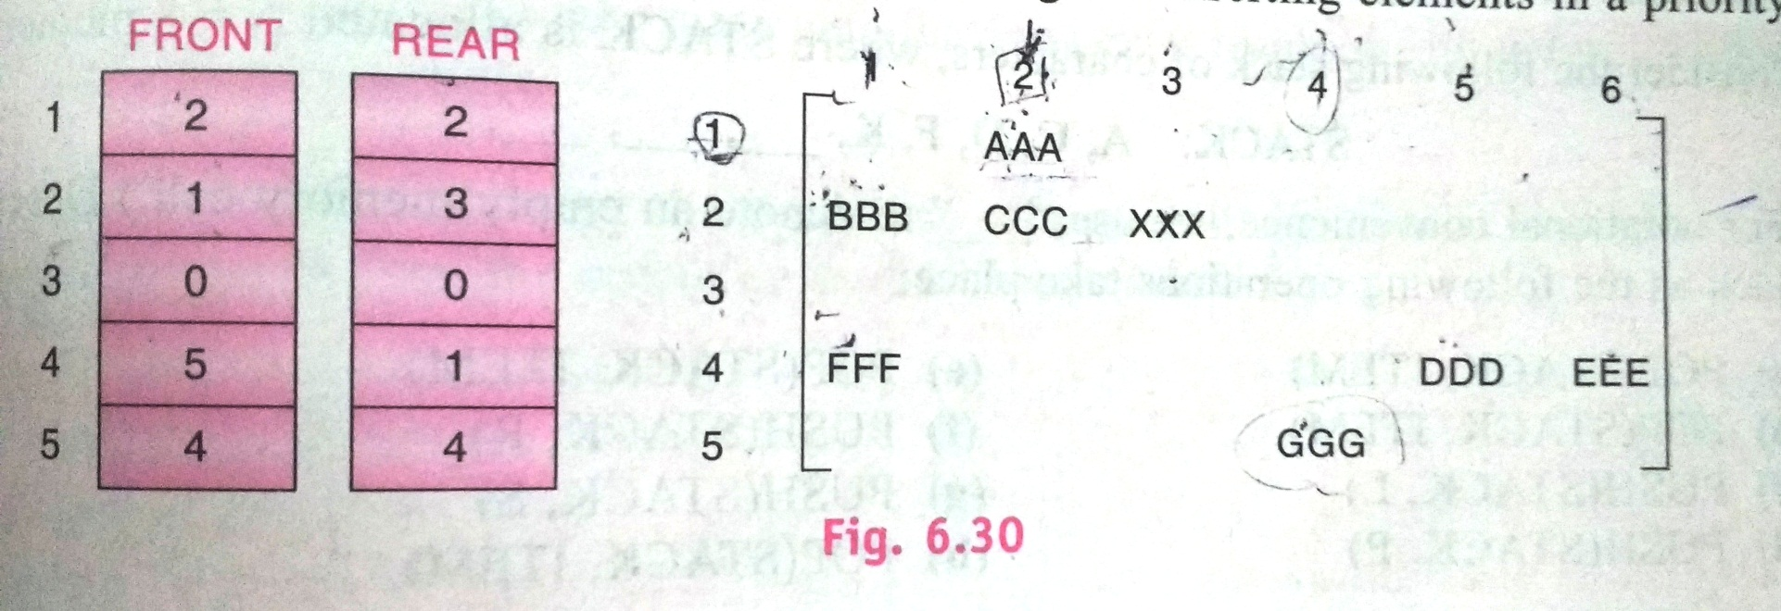
Array Representation of a Priority Queue
Use a separate queue for each level of priority
Each such queue will appear in its own circular
array & must have its own pair of pointers ,
FRONT & REAR

Slide 38
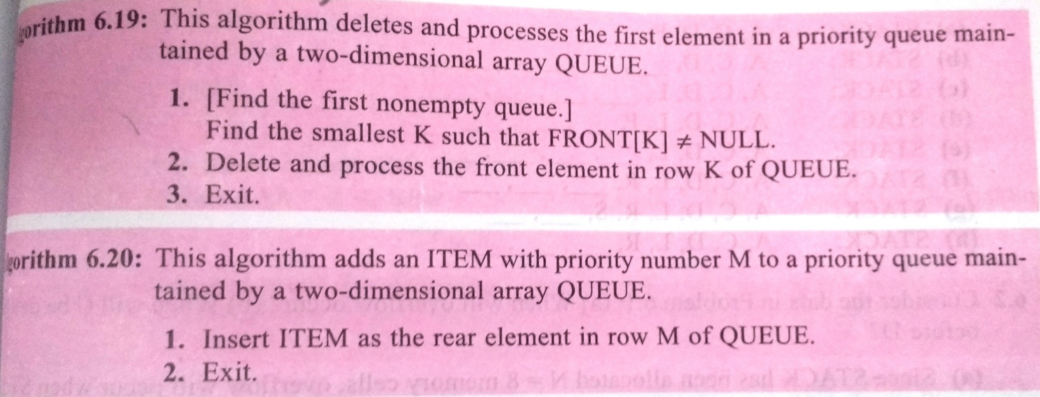
Process & Insertion

Slide 39
Multiple Stacks & Queues
Representing more than 2 stacks ,within same array
Assume , we have n stacks ,we can divide the available memory into n segments
Assume i refers to stack number of one of the n stacks
We must create indices for both the bottom & top positions of this stack
Note :
→boundary[i] , 0≤i<MAX_STACKS points to the position immediately to the left of the bottom element of stack i
→ top[i] , 0≤i<MAX_STACKS points to the top element

Slide 40
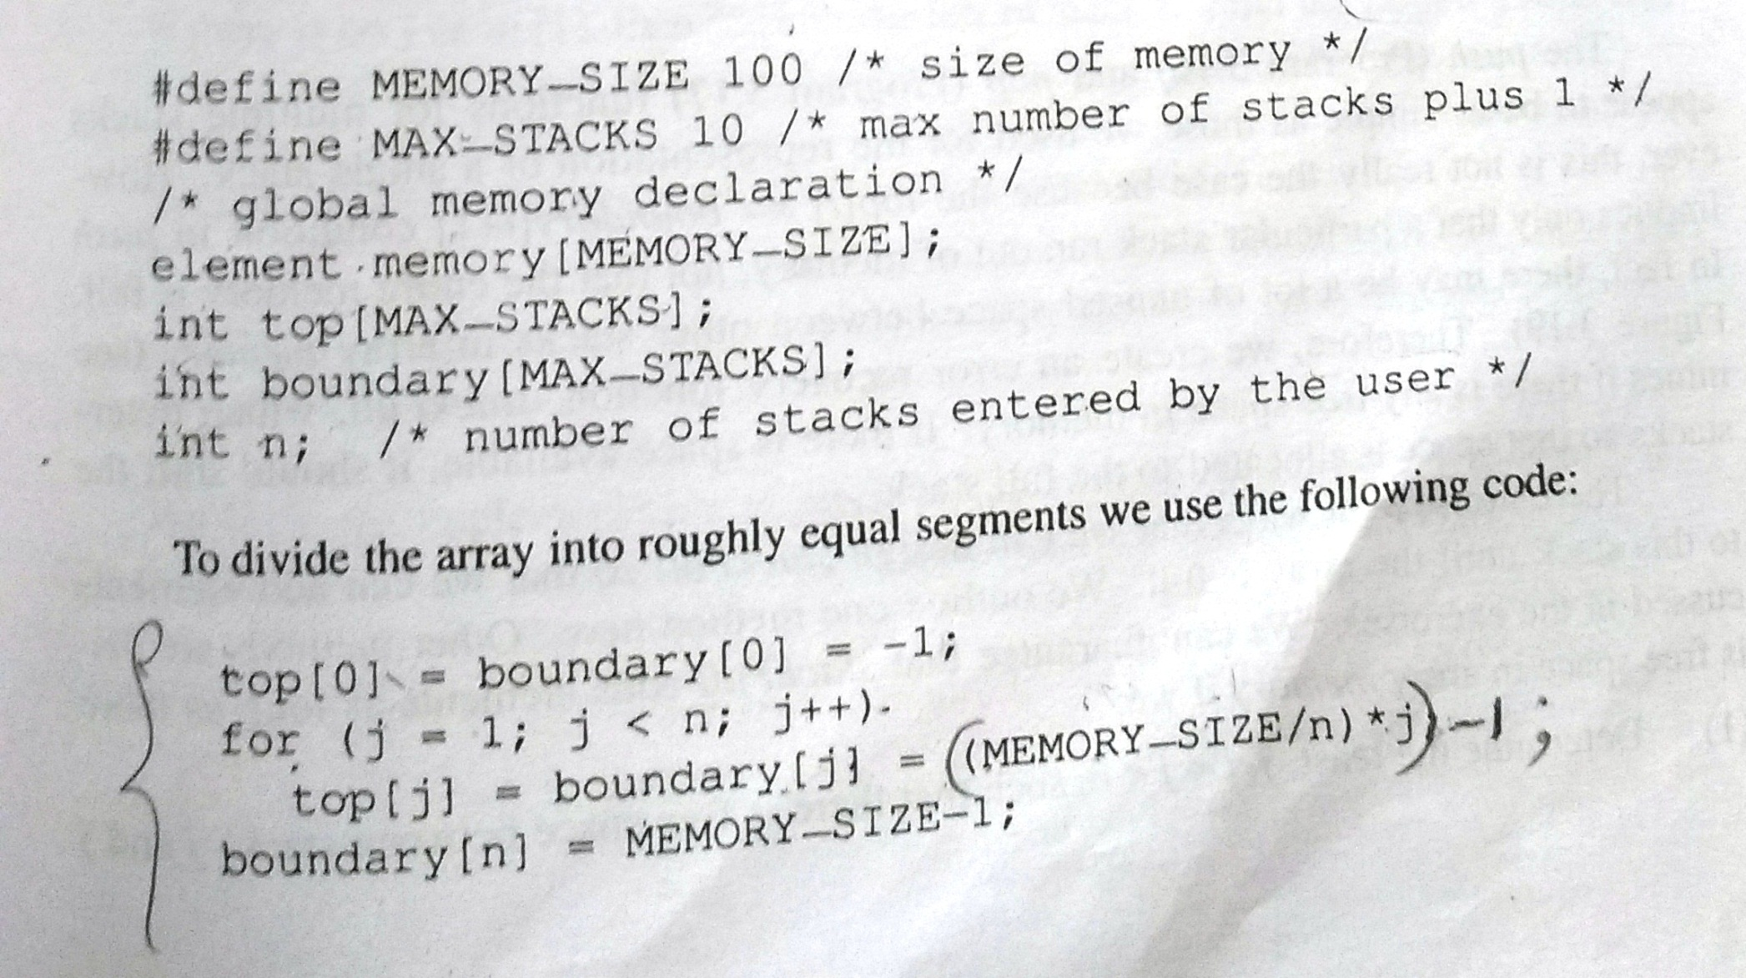

Slide 41
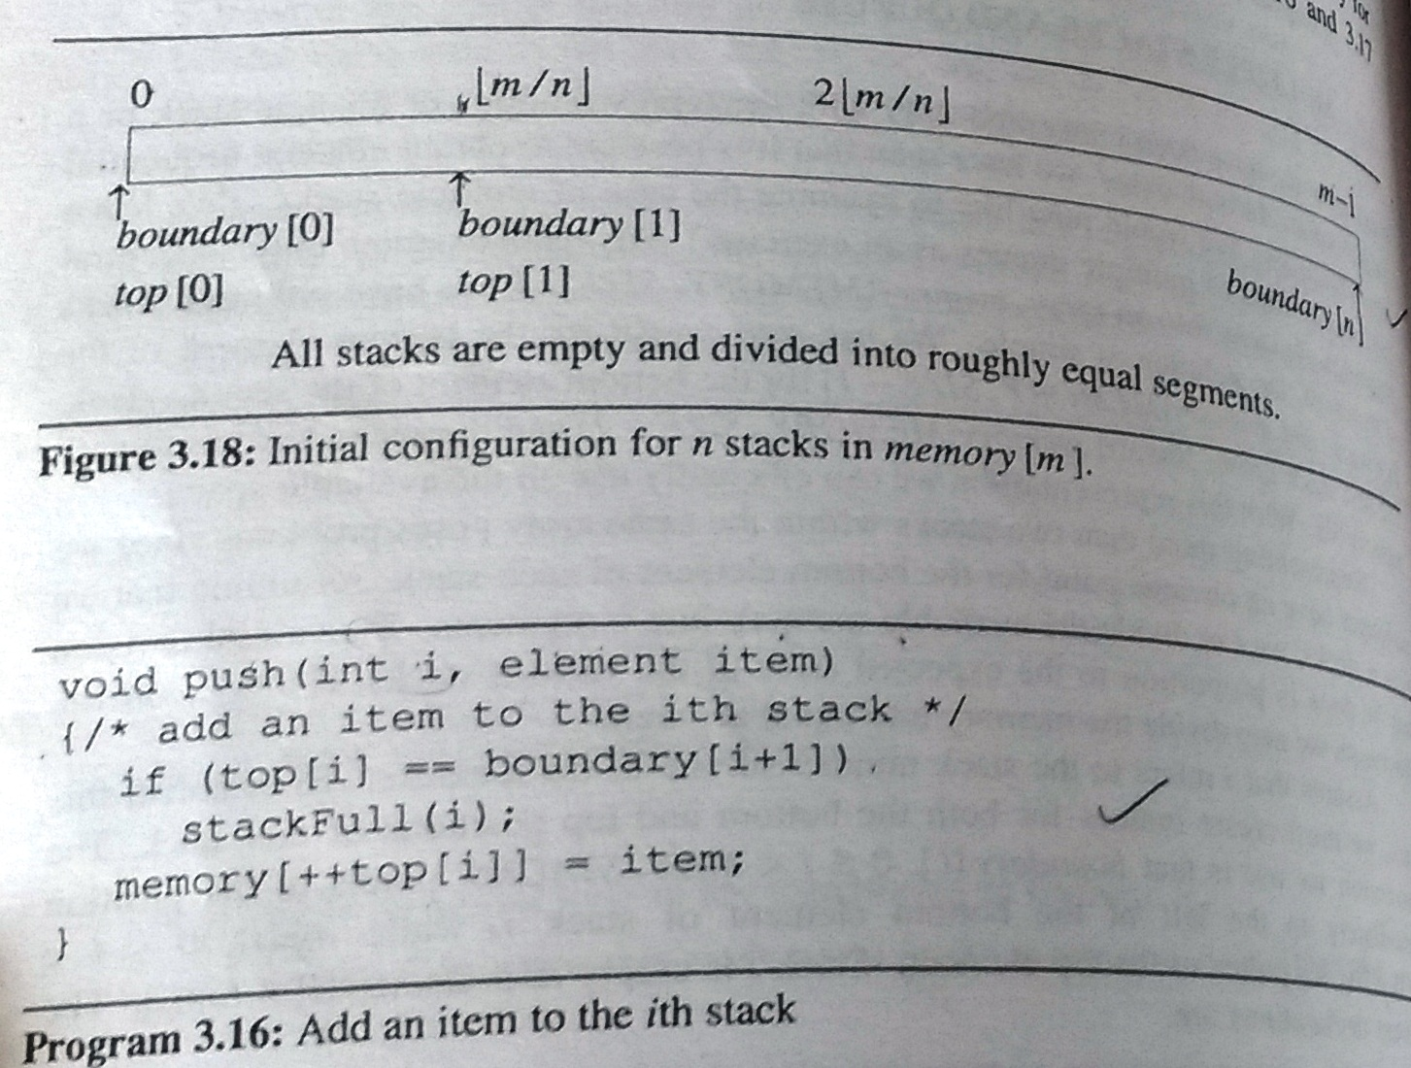
Note : StackFull =>particular stack is full

Slide 42
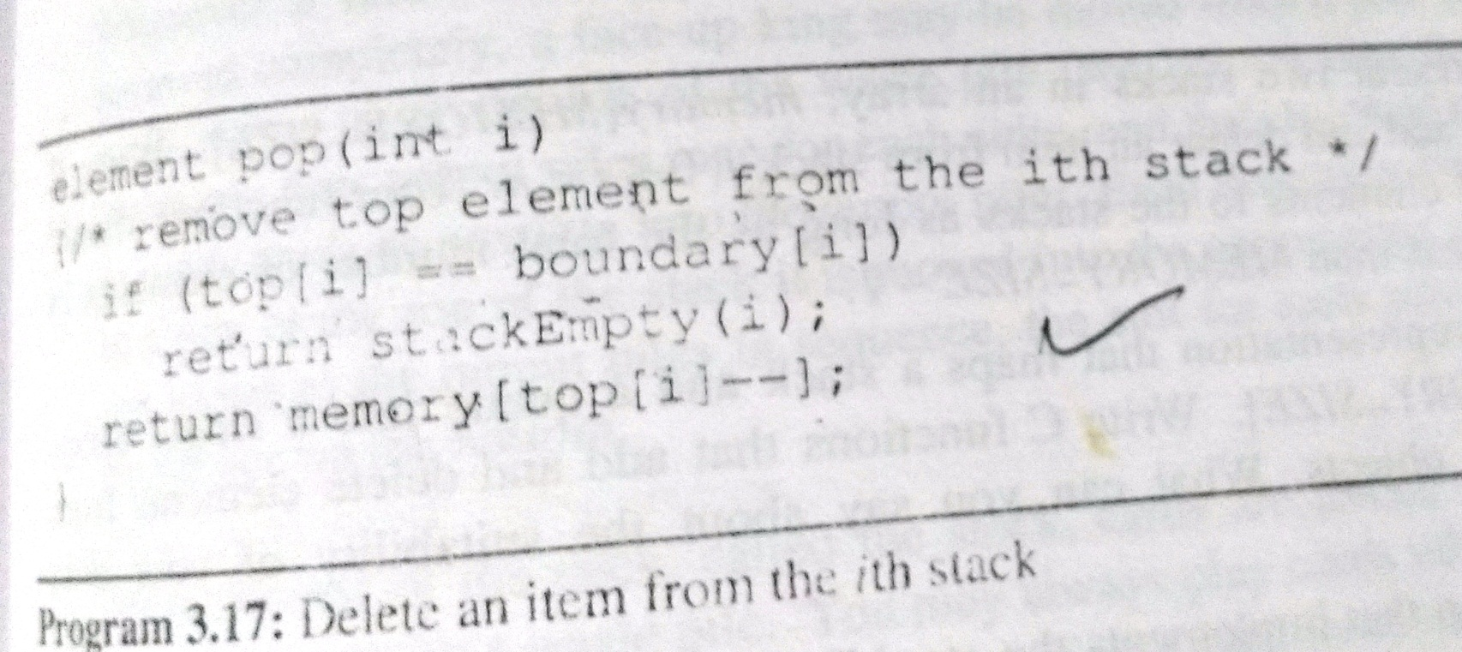

Slide 43
To guarantee stackFull adds elements as long as there is free space in array memory if we
Determine the least j , i<j<n , such that there is free space b/w stacks j & j+1.That is , top[j]<boundary [j+1].If there is such a j, then move i+1,i+2,…j one position to the right ,This creates a space b/w stack i & i+1
If there is no j as in (1),then look to the left of stack i. Find the largest j such that 0≤j<1 & there is space b/w stacks j& j+1 ,top[j]<boundary[j+1].If there is such a j , then move stacks j+1,j+2,…i one space to the left
If there no j satisfying either conditions , then all MEMORY_SIZE spaces of memory are utilized & there is no free space

Slide 44
A Mazing Problem
Entrance pos[1][1]
0 1 0 0 0 1 1 0 0 0 1 1 1 1 1
1 0 0 0 1 1 0 1 1 1 0 0 1 1 1
0 1 1 0 0 0 0 1 1 1 1 0 0 1 1
1 1 0 1 1 1 1 0 1 1 0 1 1 0 0
1 1 0 1 0 0 1 0 1 1 1 1 1 1 1
0 0 1 1 0 1 1 1 0 1 0 0 1 0 1
0 1 1 1 1 0 0 1 1 1 1 1 1 1 1
0 0 1 1 0 1 1 0 1 1 1 1 1 0 1
1 1 0 0 0 1 1 0 1 1 0 0 0 0 0
0 0 1 1 1 1 1 0 0 0 1 1 1 1 0
0 1 0 0 1 1 1 1 1 0 1 1 1 1 0
Program takes many false paths before it finds a correct one , once found it can correctly rerun maze without taking any false path
exit
[m][p]
1: blocked path 0: open path
*Figure 3.8: An example maze(p.113)

Slide 45
Eight possible directions of movement
*Figure 3.9: Allowable moves
Note : Not every position has 8 neighbors, on a border ,possibly 3
We can surround maze by a border of ones, ,thus an mxp maze requires an (m+2)x(nx2) array

Slide 46
typedef struct { short int vert; short int horiz; } offsets; offsets move[8]; /*array of moves for each direction*/
A possible implementation
next_row = row + move[dir].vert; next_col = col + move[dir].horiz;
Table of moves

Slide 47
Important Points
We need to save our current position , we can return to it & try another path if we take a hopeless path
To avoid returning to previously tried path , mark[row][col] to record maze positions already checked
EXIT_ROW & EXIT_COL gives the coordinates of the maze exit

Slide 48
Representation of stack
typedef struct{
short int row;
short int col;
short int dir;
}element;
When searching this maze for an entrance to exit path , all positions with value zero will be on stack when the exit is reached
Since an mxp maze,can have at most mp zeroes,it is sufficient for stack to have this capacity

Slide 49
Initialize a stack to the maze’s entrance coordinates and direction to north; while (stack is not empty){ /* move to position at top of stack */ <row, col, dir> = delete from top of stack; while (there are more moves from current position) { <next_row, next_col > = coordinates of next move; dir = direction of move; if ((next_row == EXIT_ROW)&& (next_col == EXIT_COL)) success; if (maze[next_row][next_col] == 0 && mark[next_row][next_col] == 0) {

Slide 50
/* legal move and haven’t been there */ mark[next_row][next_col] = 1; /* save current position and direction */ add <row, col, dir> to the top of the stack; row = next_row; col = next_col; dir = north; } } } printf(“No path found\n”); *Program 3.7: Initial maze algorithm (p.115)

Slide 51
The size of a stack?
000001
111110
100001
011111
100001
111110
100001
011111
100000
m*p
*Figure 3.11: Simple maze with a long path (p.116)

Slide 52
void path (void) { int i, row, col, next_row, next_col, dir,found = FALSE; element position; mark[1][1] = 1; top =0; stack[0].row = 1; stack[0].col = 1; stack[0].dir = 0; while (top > -1 && !found) { position = pop(); row = position.row; col = position.col; dir = position.dir; while (dir < 8 && !found) { /*move in direction dir */ next_row = row + move[dir].vert; next_col = col + move[dir].horiz; if (next_row==EXIT_ROW && next_col==EXIT_COL) found = TRUE;
(1,1)
(m,p)
(m+2)*(p+2)
else if ( !maze[next_row][next_col]
&& !mark[next_row][next_col] )
{ mark[next_row][next_col] = 1; position.row = row;
position.col = col; position.dir = ++dir; push(position); row = next_row;
col = next_col;
dir = 0; } else ++dir; } }

Slide 53
if (found) { printf(“The path is :\n”); printf(“row col\n”); for (i = 0; i <= top; i++) printf(“ %2d%5d”, stack[i].row, stack[i].col); printf(“%2d%5d\n”, row, col); printf(“%2d%5d\n”, EXIT_ROW, EXIT_COL); } else printf(“The maze does not have a path\n”); } *Program 3.8:Maze search function

Slide 54
Stack Application :Polish Notation
Three levels of precedence for usual binary operations
Highest : Exponentiation(^)
Next highest : Multiplication (*) and division(/)
Lowest : Addition(+) and subtraction(-)
Types of Expression
1. Infix : we place a binary operator in b/w its two operands
Ex : a+b
2. Prefix/Polish : In this , each operator appears before the operands Ex : +ab
3. Postfix/Suffix/Reverse Polish : In this ,each operator appears after its operands Ex : ab+

Slide 55
Evaluation of a Postfix Expression
Scan left-to-right
Place the operands on a stack until an operator is found
Performs operations
→Pop two operands from the stack
→Perform the specified operation
→Push the result back on the stack
Ex : 1) 562+*41/-
2)62/3-42*+
3)abc-d+/ea-*e* (a=b=2 ,c=d=4 , e=5)

Slide 56
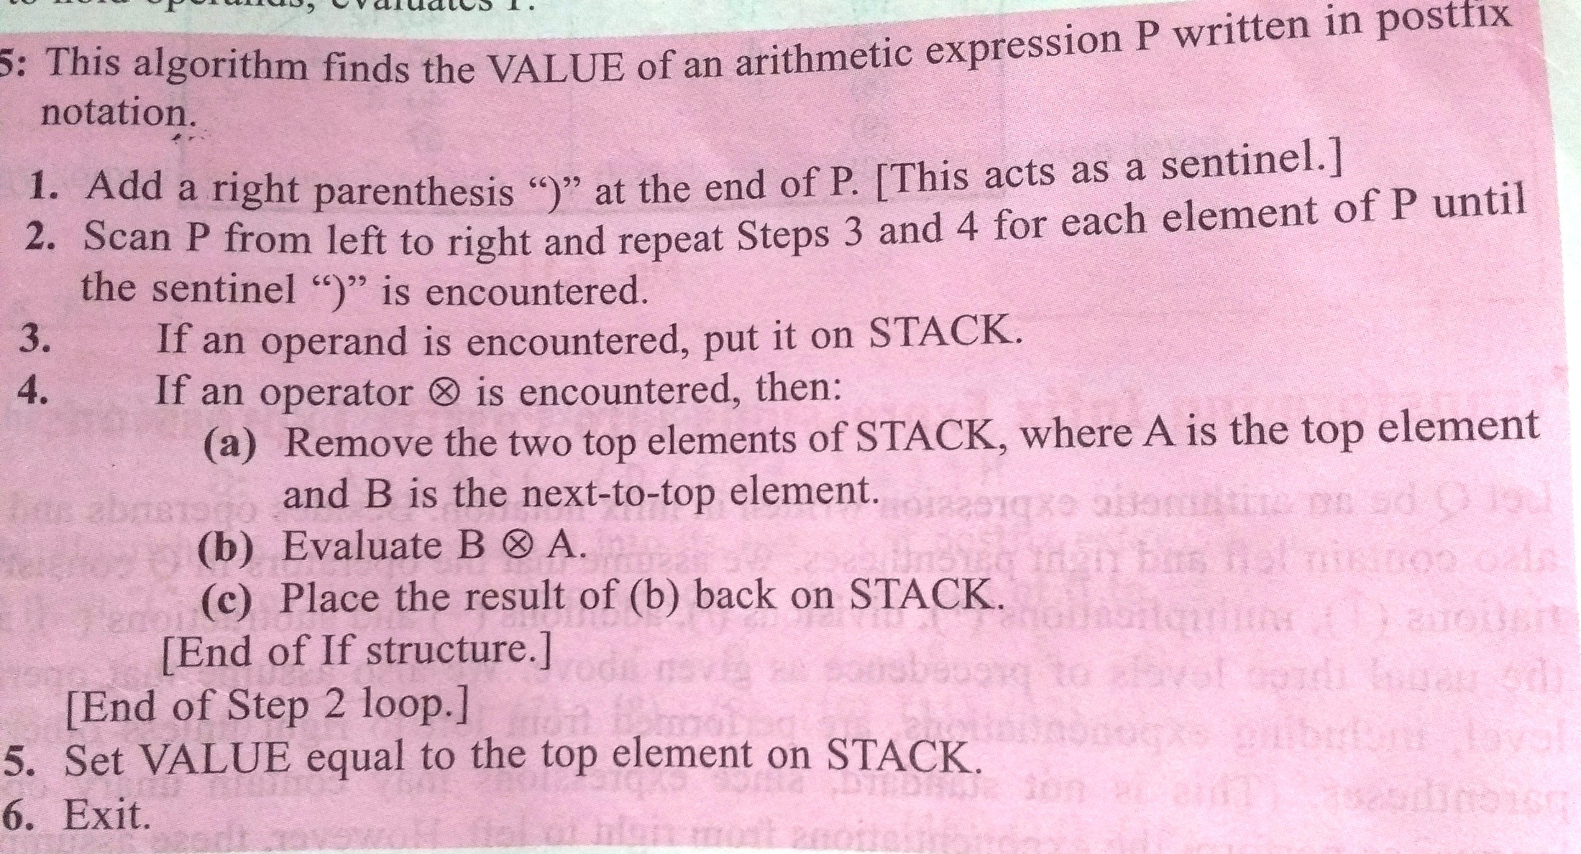
Evaluation Of Postfix Expression

Slide 57
